Slide 1
Lab assignment 3 Hopfield networks

Slide 2
Convergence and attractors
New patterns for x1d, x2d, x3d: [-1. -1. 1. -1. 1. -1. -1. 1.] [-1. 1. -1. -1. -1. 1. -1. -1.] [-1. 1. 1. -1. -1. 1. -1. 1.] | x1d and x3d converge towards stored patterns, but x2d does not converge toward x2.
[-1 -1 -1 -1 -1 1 -1 -1] [-1 -1 -1 -1 1 -1 -1 -1] [-1 -1 1 -1 -1 1 -1 1] [-1 -1 1 -1 1 -1 -1 1] [-1 -1 1 -1 1 1 -1 1] [-1 1 -1 -1 -1 1 -1 -1] [-1 1 1 -1 -1 1 -1 1] [-1 1 1 -1 1 -1 -1 1] [ 1 -1 -1 1 1 -1 1 -1] [ 1 1 -1 1 -1 1 1 -1] [ 1 1 -1 1 1 -1 1 -1] [ 1 1 -1 1 1 1 1 -1] [ 1 1 1 1 -1 1 1 1] [ 1 1 1 1 1 -1 1 1] | There are 14 attractors in the network.

Slide 3
Convergence and attractors
Three input patterns have 5 bit errors, compared with x1, x2 and x3: [1, 1, -1, 1, -1, -1, -1, 1] [1, 1, 1, 1, 1, 1, -1, -1] [1, -1, -1, 1, 1, 1, -1, 1] | New patterns: [ 1. 1. 1. 1. 1. -1. 1. 1.] [ 1. 1. 1. 1. 1. -1. 1. 1.] [ 1. -1. -1. 1. 1. -1. 1. -1.]
When the starting pattern is very dissimilar to the stored ones, the recalled patterns can not converge towards stored patterns.

Slide 4
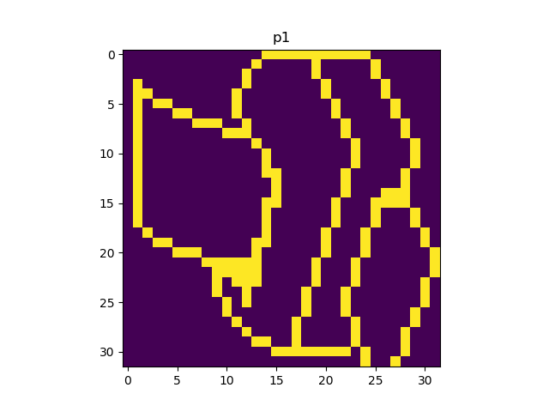

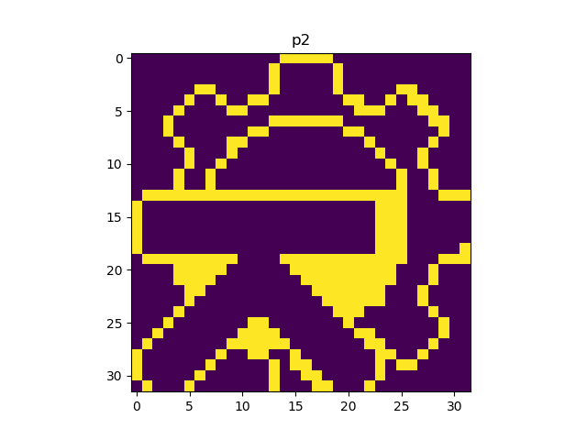
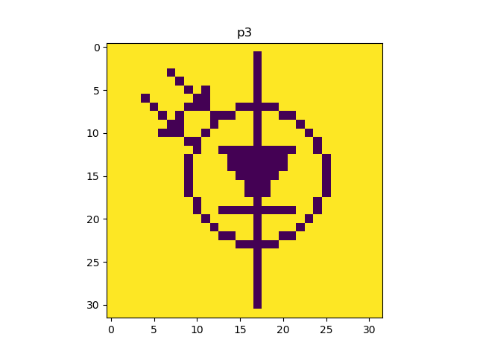
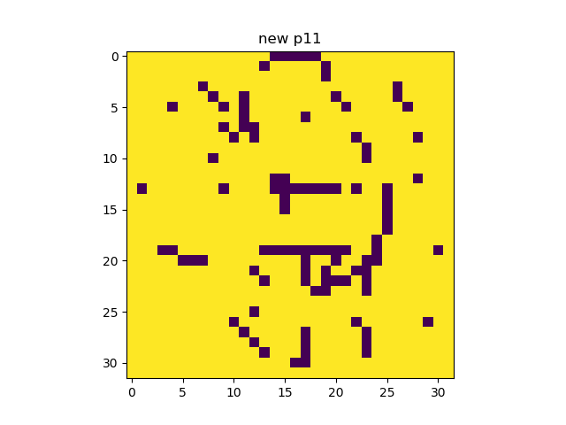
Sequential Update
The three patterns are stable.
For P10, the network can complete a degraded pattern through the synchronous update.
For P11, it fails.

Slide 5
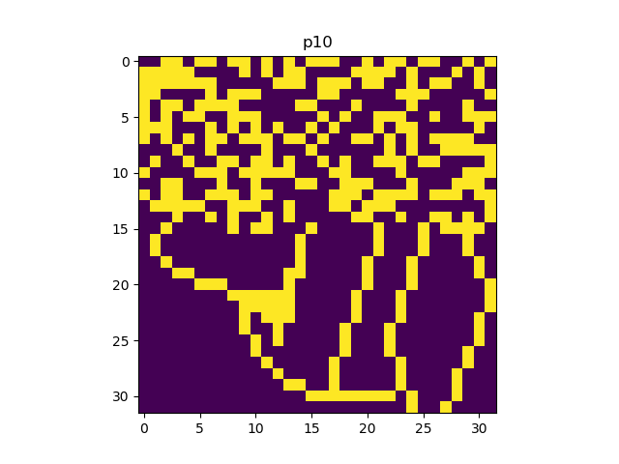
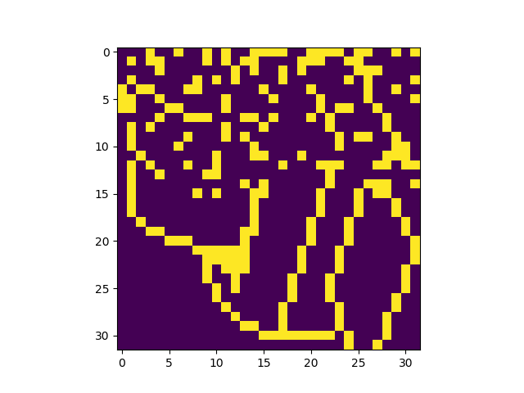
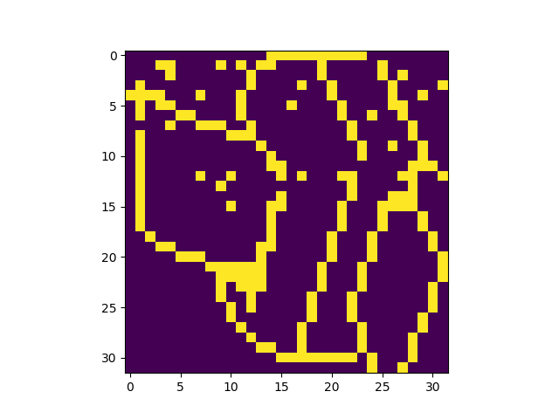
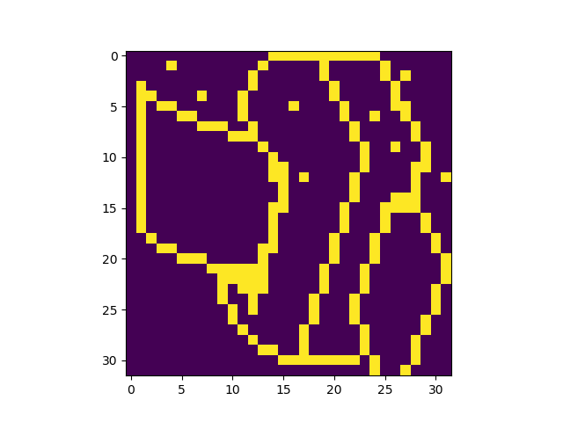

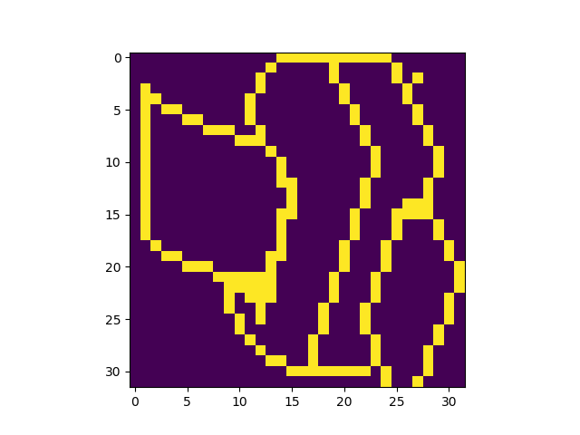

Random Sequential Update P10

Slide 6
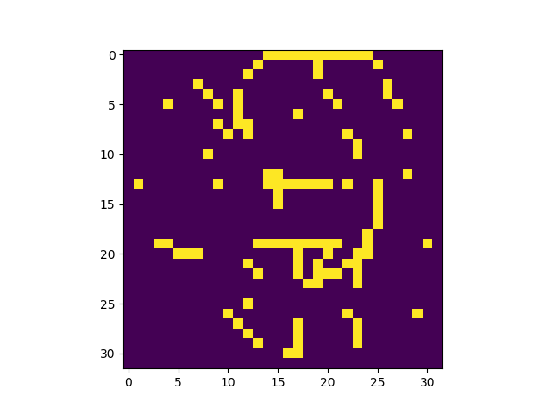
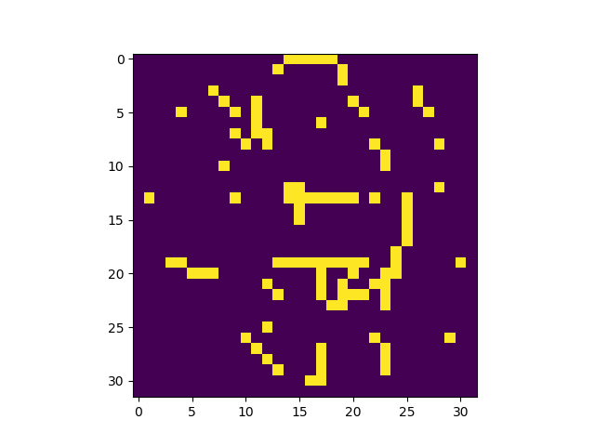
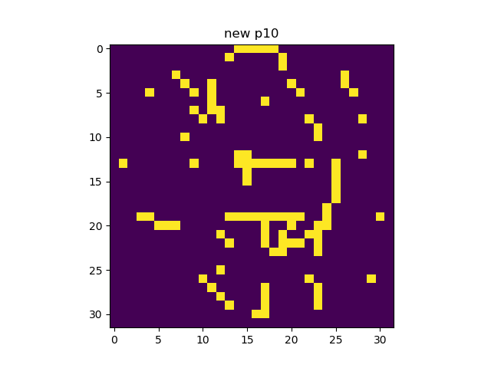
Original Sequential Update P10

Slide 7
Energy
Attractors:
the energy at p1 is -1439.390625
the energy at p2 is -1365.640625
the energy at p3 is -1462.25
The distorted patterns:
the energy at p10 is -415.98046875
the energy at p11 is -173.5

Slide 8
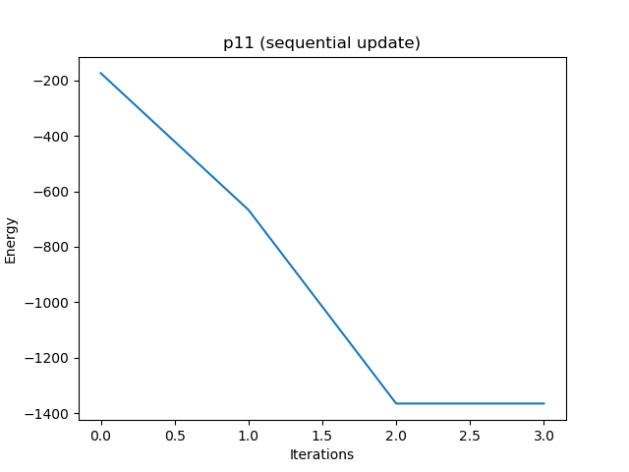
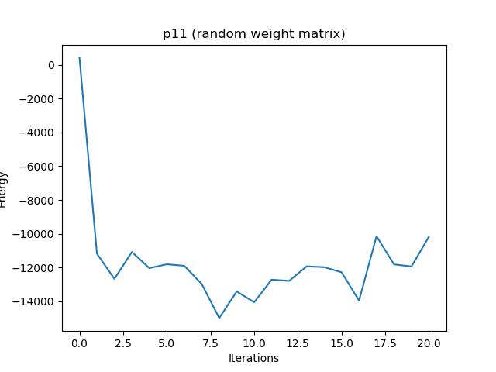
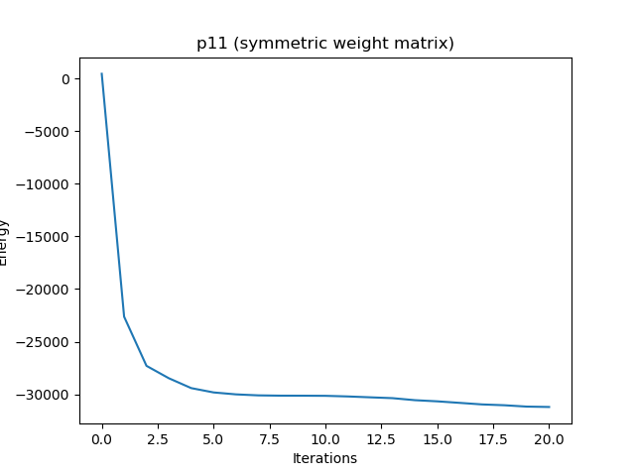
Energy
The energy decreases.
The energy does not always decrease,
oscillates between states.
The energy decreases
because the matrix is symmetric.

Slide 9

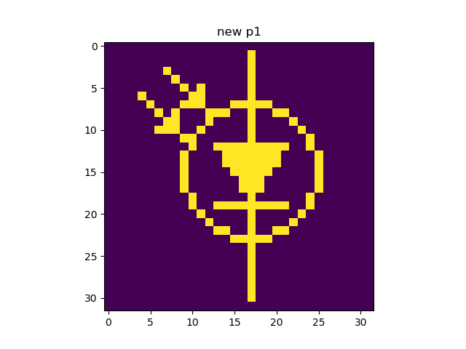

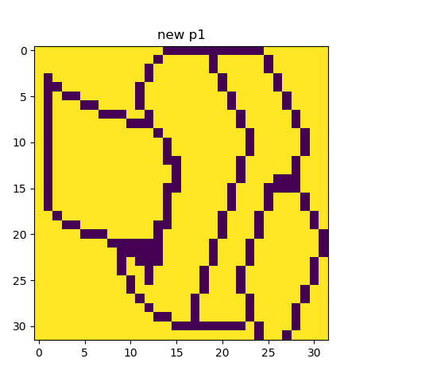
Distortion Resistance P1
40% of the noise can be removed.
For 0%, 10%, 20%, 30%, 40% of noise
For 50% of noise
For 60% of noise
For 70%, 80%, 90%,
100% of noise

Slide 10



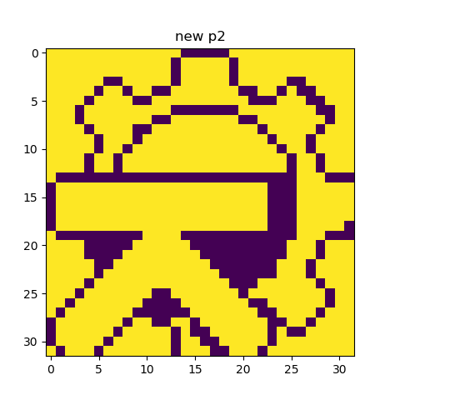
Distortion Resistance P2
40% of the noise can be removed.
For 0%, 10%, 20%, 30%, 40% of noise
For 50% of noise
For 60% of noise
For 70%, 80%, 90%,
100% of noise

Slide 11




Distortion Resistance P3
30% of the noise can be removed.
For 0%, 10%, 20%, 30% of noise
For 40% of noise
For 50% of noise
For 60%, 70%, 80%, 90%,
100% of noise

Slide 12
Distortion Resistance
Generally, 40% of noise can be removed.
There is no difference between the three attractors with regard to noise tolerance.
The network will not converge to the right attractors if the noise level is too high. The extra iterations do not help. The inverses of the three attractors are also attractors.

Slide 13
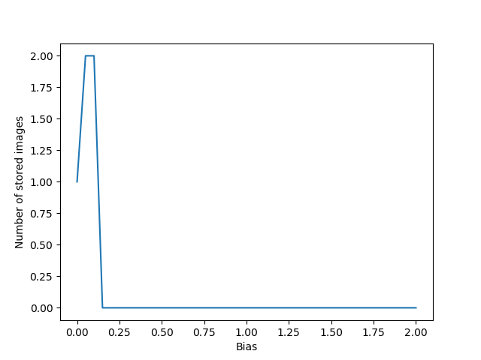
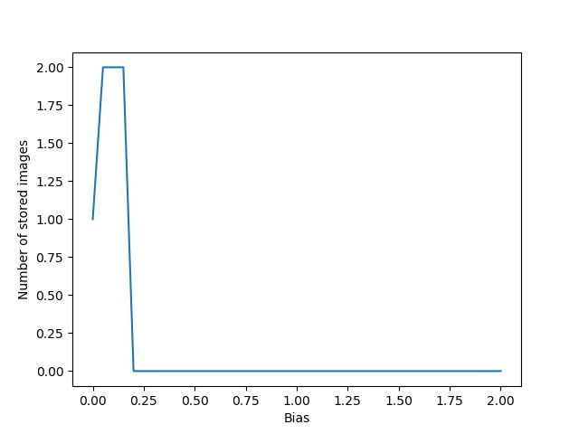
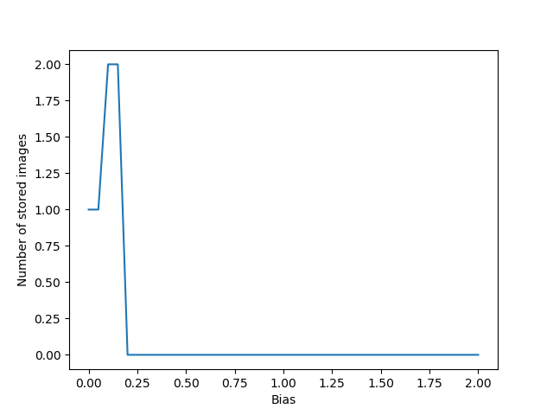
Sparse Patterns
ρ = 0.1
ρ = 0.05
ρ = 0.01

